Slide 1
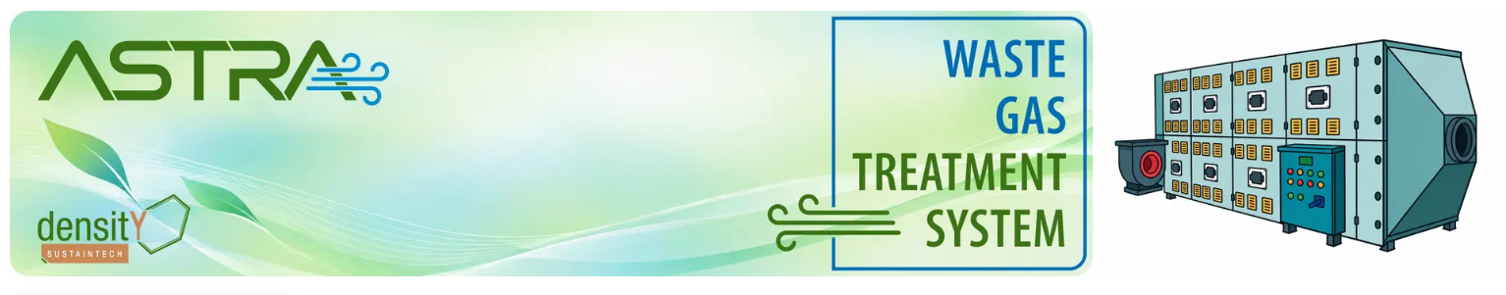
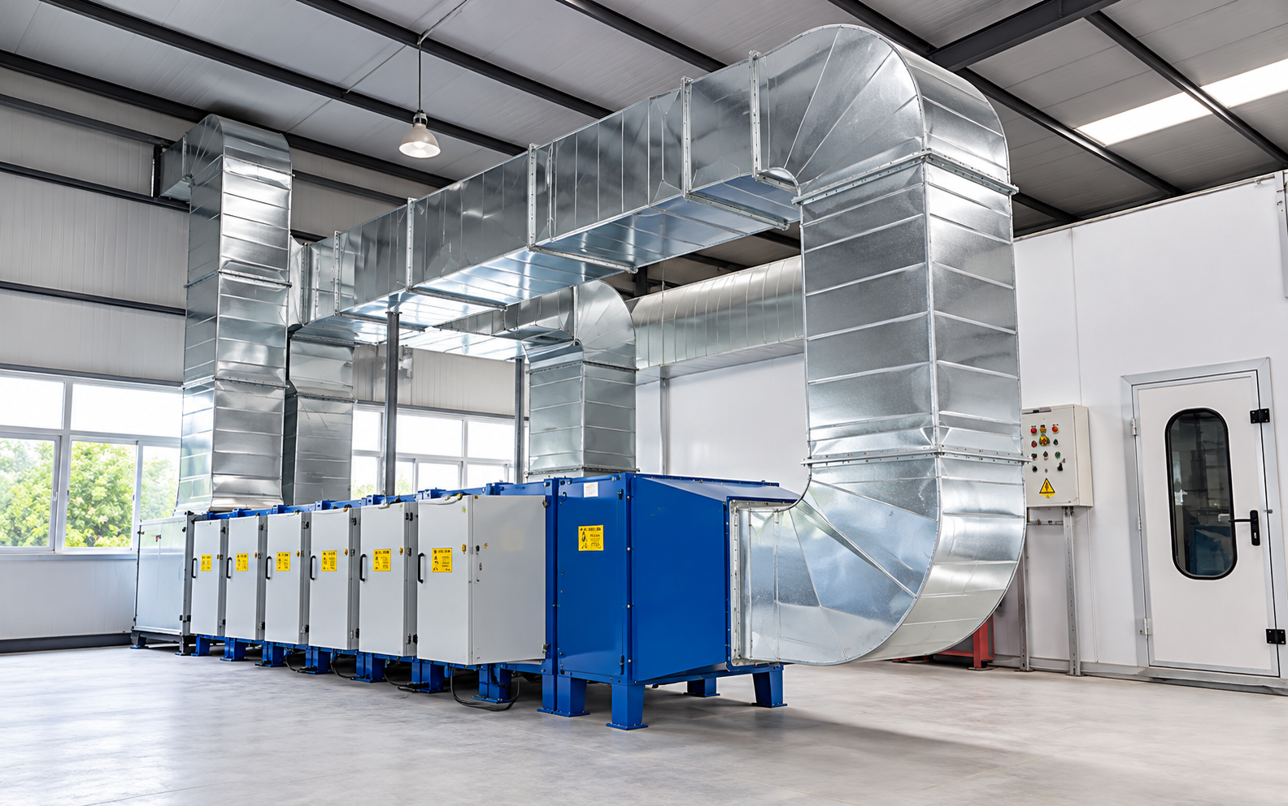
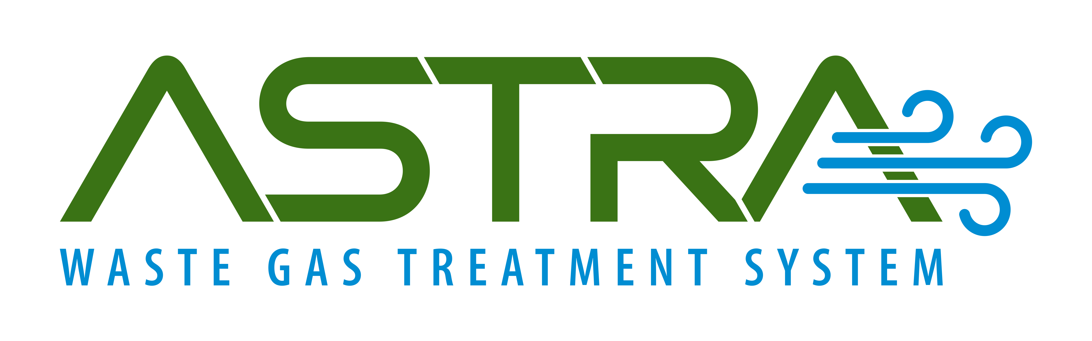

ASTRA™ is an advanced, non-combustion technology for treating volatile organic compounds (VOCs) and hazardous gaseous pollutants. Using microwave-assisted UV photocatalytic oxidation, it breaks down pollutant molecules at low operating temperatures of below 70°C, without fuel, flames, or water. With treatment efficiency exceeding 95%, ASTRA™ transforms harmful emissions into less harmful byproducts, without generating secondary liquid or solid waste.
Low-Temperature Processing (<70°C): Treats hazardous organic and inorganic gaseous emissions without combustion, open flames, or associated fire hazards.
>95% Treatment Efficiency: Effectively degrades complex VOC mixtures, including ketones, aromatic compounds, and chlorinated species.
Zero Secondary Waste: Eliminates wastewater generation and the need for hazardous spent-carbon disposal.
SELECT YOUR WASTE GAS TO SEE WHAT
CAN DO!
Flexible Deployment: Available as fixed plant skids, containerized mobile (OTG) units, compact over-the-top systems, and in-situ solutions for VOC treatment in fume hoods and workbench ventilation systems.
DOWNLOAD BROCHUIRE
CONTACT US

Slide 2

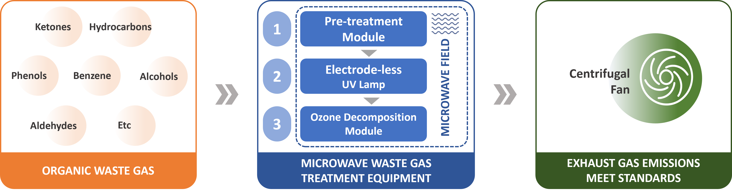



Microwave Lysis Technology
Meets industry emission standards and handles complex mixed exhaust gases
Uses microwave & VUV light to break molecular bonds at room temperature
Integrates easily with PLC/DCS systems; plug-and-play with simple maintenance
Flexible design - available as a single unit or modular setup
Achieves up to 99% styrene breakdown with minimal byproduct risk (producing only CO₂ & H₂O)
Low operating cost: electricity plus periodic UV lamp replacement
Working Principle
<70ºC
110-240 V
<85%

Slide 3
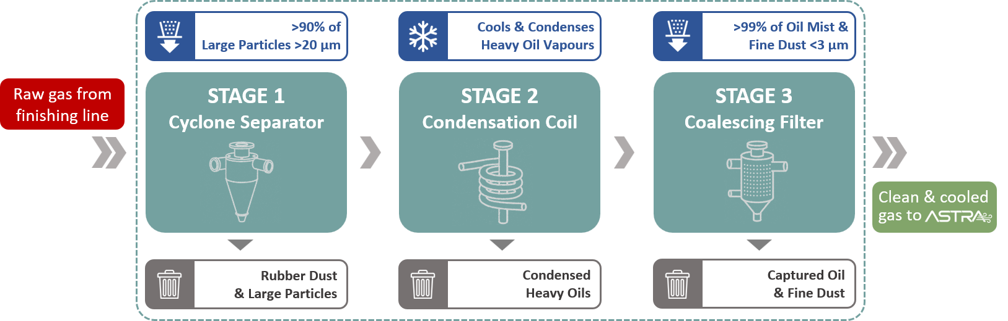
Working Principle
<70ºC
110-240 V
<85%
Plug-n-Play Pre-treatment Ready Architecture

Slide 4
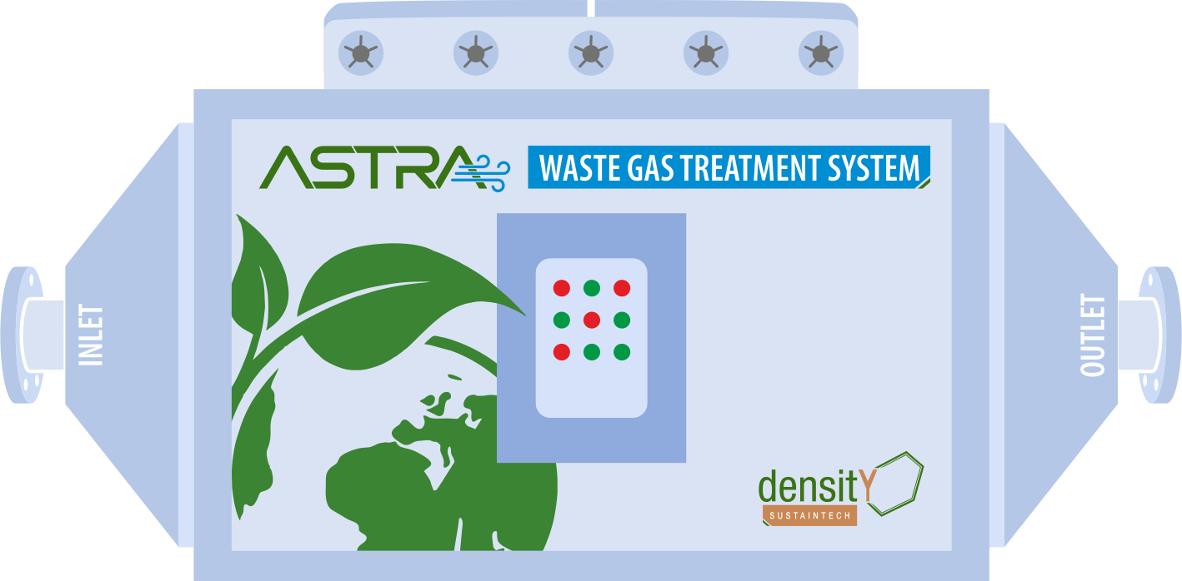

SELECT YOUR GAS
OUTPUT
Complete list of Gases treated by

Slide 5
Gases Treated
Gas | Mol. Formula | Mol. Wt. | Main Chemical Bonds | Bond Energies (kJ/mol) | End Products
Ammonia | NH₃ | 17 | H-N | 389 | H₂O, N₂
Aniline | C₆H₅NH₂ | 93 | ϖ bond, C-H, N-H, C-C | <611,414,389,332 | H₂O, CO₂, N₂
Benzene | C₆H₆ | 78 | ϖ bond, C-H | <611,414 | H₂O, CO₂
Dimethyl disulfide | C₂H₆S₂ | 94 | S-S, H-S, S-C, C-H | 268,339,268,414 | H₂O, CO_{2,} SO₄²⁻
Ethyl acetate | C₄H₈O₂ | 88 | C-H, C-O, C=O, C-C | 414,326,728,332 | H₂O, CO₂
Ethylene oxide | C₂H₄O | 44 | C=C, C-O, C-H | 611,326,414 | H₂O, CO₂
Hydrogen Sulfide | H₂S | 34 | H-S | 339 | H₂O, SO₄²⁻
Methanol | CH₃OH | 32 | C-H, C-O, H-O | 414,326,464 | H₂O, CO₂
Methyl mercaptan | CH₄S | 48 | C-S, C-H, H-S | 272,414,339 | H₂O, CO₂, SO₄²⁻
Methyl sulfide | C₂H₆S | 62 | C-C, C-H, C-S | 332,414,272 | H₂O, CO₂, SO₄²⁻
Phenol | C₆H₅OH | 94 | ϖ bond, C-H, C-O | 611,414,326 | H₂O, CO₂
Styrene | C₈H₈ | 104 | C=C,C-C, C-H, ϖ bond | 611,332,414, | H₂O, CO₂
Toluene | C₇H₈ | 92 | ϖ bond, C-H, C-C | 61,14,14,332 | H₂O, CO₂
Trimethylamine | C₃H₉N | 59 | C-H, C-N | 414,305 | H₂O, N₂, CO₂
Xylene | C₆H₄(CH₃)₂ | 106 | ϖ bond, C-H, C-C | 611,414,332 | H₂O, CO₂

Slide 6
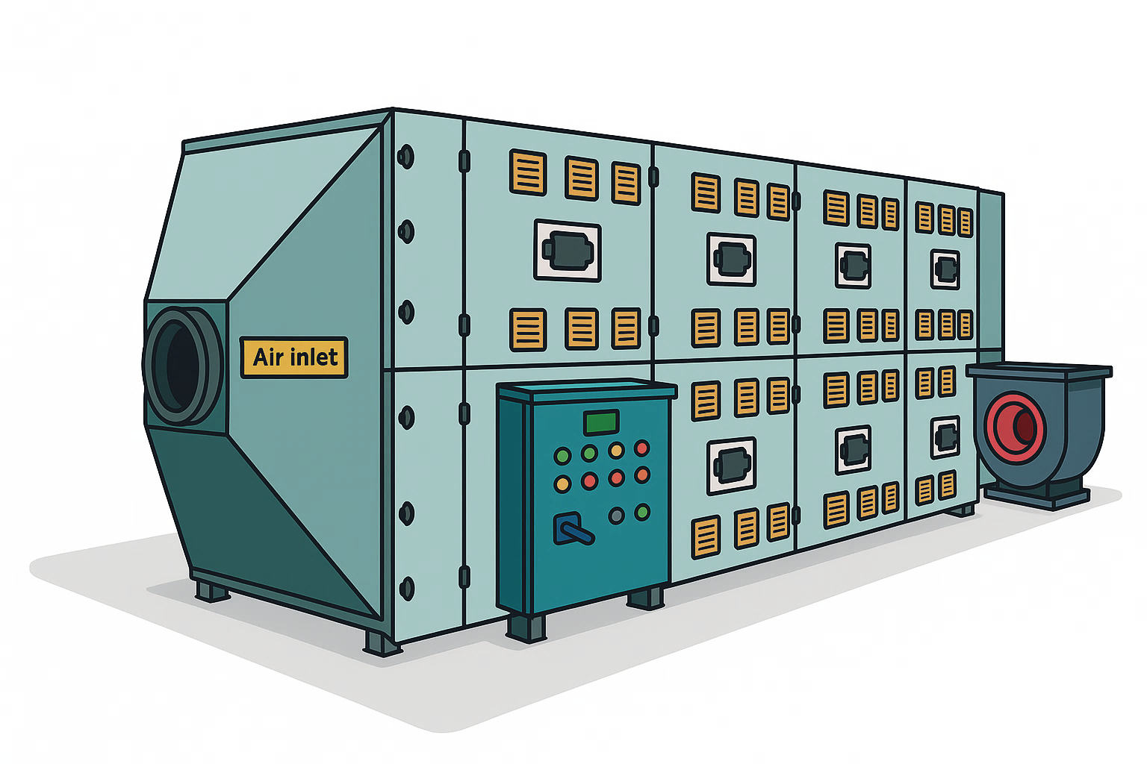

Astra vs Conventional Technology
Feature | Thermal Oxidation | VUV Technology
Working Principle | High-temperature thermal oxidation (~760°C+) | Microwave & Ultraviolet (VUV) at room temperature
Pretreatment Needs | Required for particles & oil | Required for particles & oil
System Configuration | Single large unit often preferred for cost-effectiveness | Highly flexible; single unit or multiple modules possible
Footprint | Large (due to ceramic heat recovery beds) | More compact; modular design
Energy Consumption | High fuel demand to maintain temperature; electricity for fans | Primarily electricity (no fuel); lower OPEX
OPEX Drivers | Natural gas, periodic ceramic media replacement | Electricity, periodic lamp replacement
By-product Risks | NOx, potential SO₂ from sulfur content | Minimal; primary by-products are CO₂ and H₂O
The Advantage
Significantly Lower Operating Costs (OPEX)
Compact and Modular Design
Ambient Temperature Operation
Precision Destruction of styrene gas

Slide 7



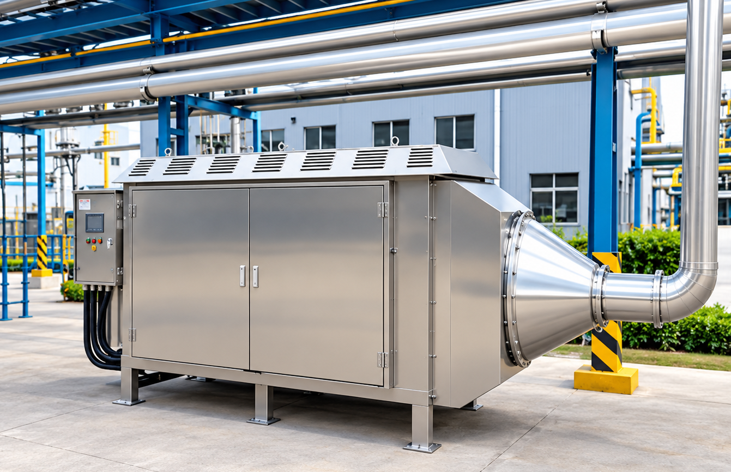
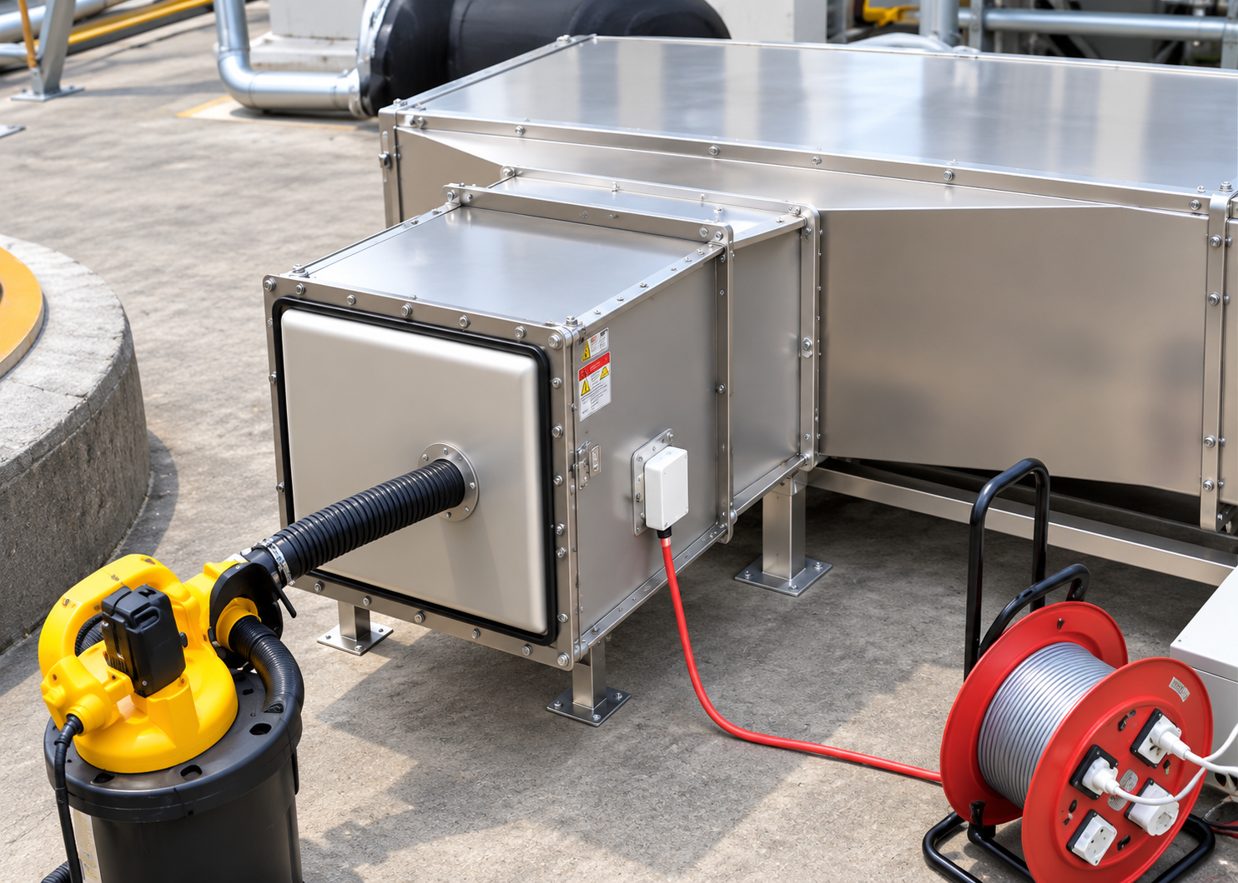
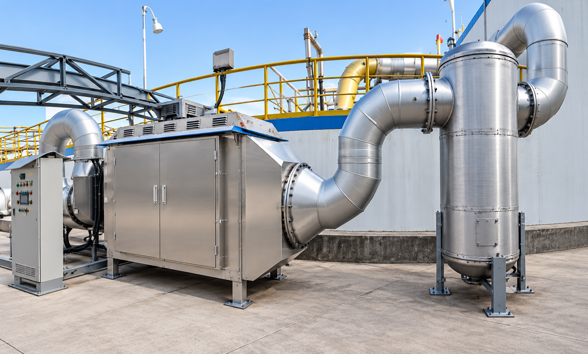
Industries Covered
Pharmaceutical, Specialty Chemical, Petrochemical, Automobile, Power generation, Cement and more.
Active Installations
Pharmaceutical
Specialty Chemical
Petrochemcial
Products Manufactured
Human & veterinary drugs with a primary focus on antibiotic APIs, synthetic drugs formulations
Nitrosylsulfuric acid, Acrylonitrile m-Aminoacetanilide, 1-Aminoanthraquinone , N-Diallyl-2-methoxy-5-acetaminoaniline, etc.
Butene, MTBE, Mixed C4 Hydrocarbon, Mixed C5 Hydrocarbons, Mixed Pentenes, Propylene, Ethylene, Methanol, Naphtha
Effluent Gases
VOCs & odorous compounds
VOCs`
VOCs, NH₃, H₂S, Phenol
Treatment Outcome
>90% treatment efficiency, reducing exhaust conc. to 0–59 mg/m³.
>98% VOC removal, reducing exhaust conc. from 9,837–14,682 mg/m³ to 89.5–246 mg/m³.

Slide 8





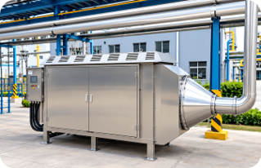
INDUSTRY
SOLUTIONS
LABORATORY
SOLUTIONS
MOBILE
SOLUTIONS
One-of-a-kind Industrial Solution
Wide Industry Coverage
Pharma & BioPharma, Electronics – Semicon, Chemical, Power, Cement, Steel etc.
Adapts to diverse VOC and odour treatment applications.
Application-Specific Engineering: Multiple pre-treatment configurations for challenging gas streams
Plug-and-Play Modular Design: Clean, compact, and scalable system architecture
Power-Only Technology: No fuel, water, chemicals, or secondary waste generation.
Sustainable High-Efficiency Operation: Reliable performance, low operating costs and minimal footprint
Compatible with Industrial Automation.
Configurable with PLC &DCS.
I AM INTERESTED

Slide 9
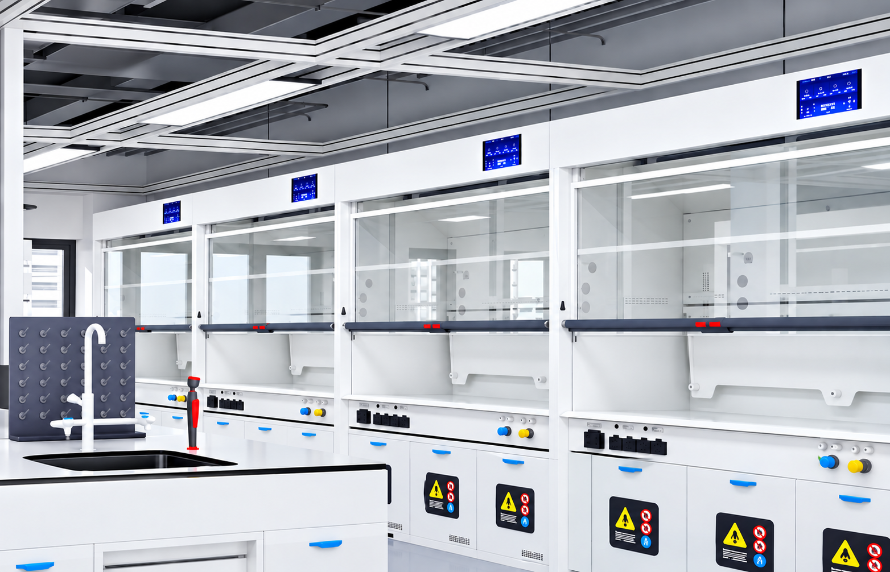
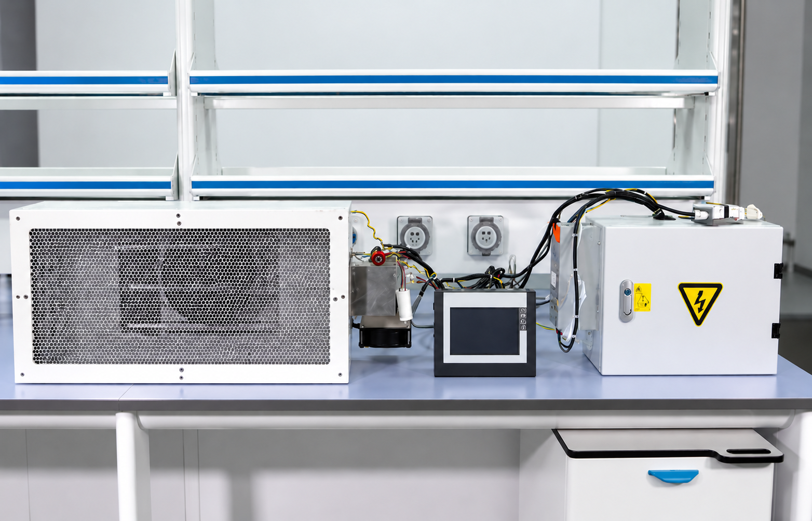
INDUSTRY
SOLUTIONS
LABORATORY
SOLUTIONS
MOBILE
SOLUTIONS
Fume Hood Companion
No Water Consumption, Wastewater Generation, Carbon Media Replacement or Chemical Dosing
Point-of-source Treatment
Compact & Retrofit Friendly
Low Maintenance Operation
Broad VOC Compatibility
Enhanced EHS Performance
Sustainability-driven Design
Lower Total Cost of Ownership
Destruction of Pollutants.
Not Transfer.
I AM INTERESTED

Slide 10
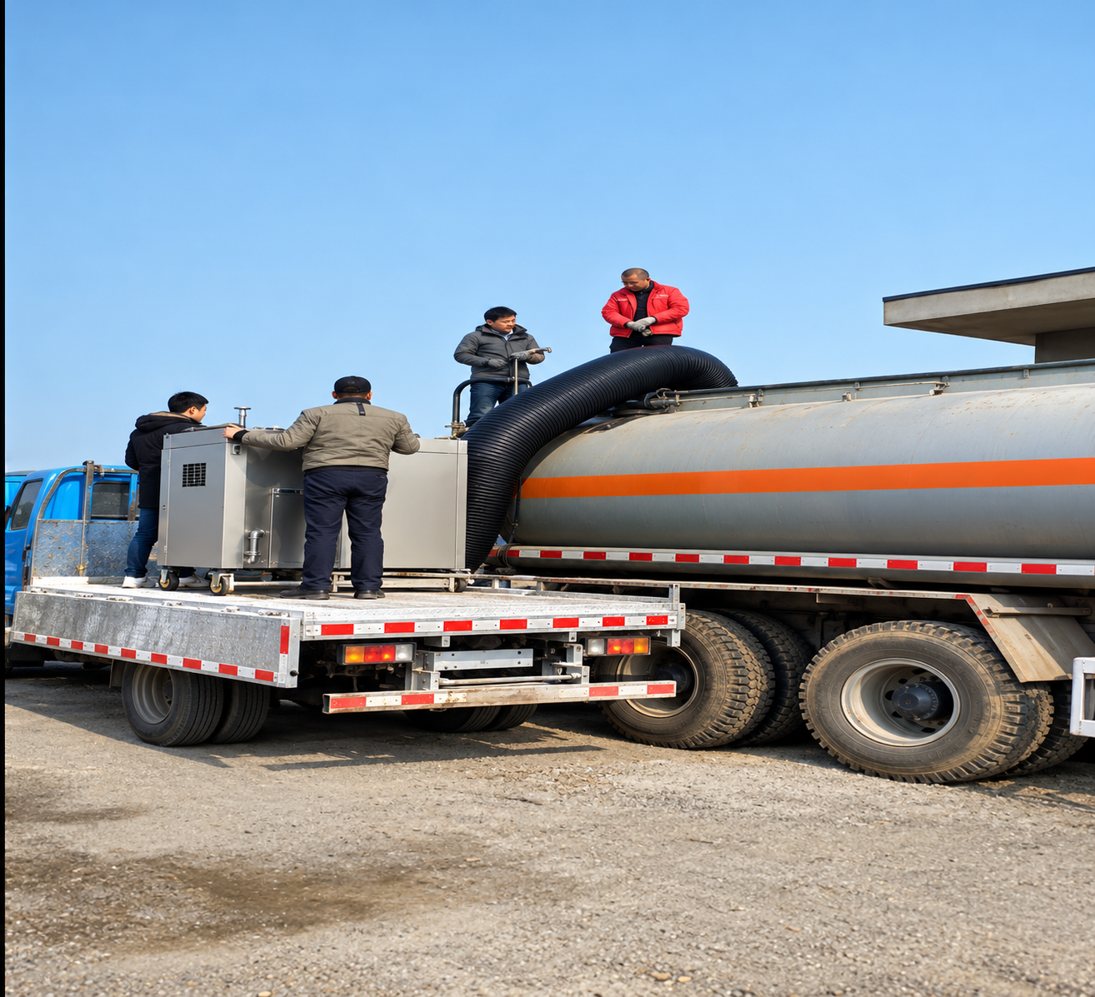
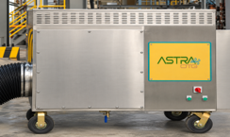
INDUSTRY
SOLUTIONS
LABORATORY
SOLUTIONS
MOBILE
SOLUTIONS
The perfect on-the-go unit.
Provides flexibility to move around in the industry unit
No combustion; no flame/flare needed
Works at ambient temperature (ATP)
Suitable for low- medium-high VOC concentrations
Broad VOC Compatibility
Enhanced EHS Performance
Compact system; good for loading racks
No recycling or ETP treatment
Mobile shield against
Hazardous VOC exposure.
I AM INTERESTED

